Slide 1
Fundamentals of Python:
From First Programs Through Data Structures
Chapter 16
Linear Collections: Lists

Slide 2
Objectives
After completing this chapter, you will be able to:
Explain the difference between index-based operations on lists and position-based operations on lists
Analyze the performance trade-offs between an array-based implementation and a linked implementation of index-based lists
Fundamentals of Python: From First Programs Through Data Structures

Slide 3
Objectives (continued)
Analyze the performance trade-offs between an array-based implementation and a linked implementation of positional lists
Create and use an iterator for a linear collection
Develop an implementation of a sorted list
Fundamentals of Python: From First Programs Through Data Structures

Slide 4
Overview of Lists
A list supports manipulation of items at any point within a linear collection
Some common examples of lists:
  Recipe, which is a list of instructions
  String, which is a list of characters
  Document, which is a list of words
  File, which is a list of data blocks on a disk
Items in a list are not necessarily sorted
Items in a list are logically contiguous, but need not be physically contiguous in memory
Fundamentals of Python: From First Programs Through Data Structures

Slide 5
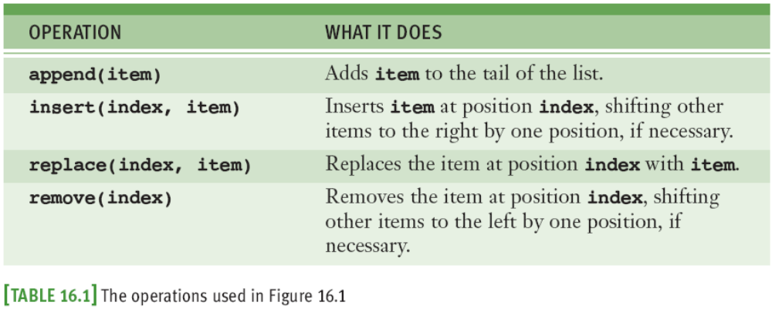
Overview of Lists (continued)
Head: First item in a list
Tail: Last item in a list
Index: Each numeric position (from 0 to length – 1)
Fundamentals of Python: From First Programs Through Data Structures

Slide 6
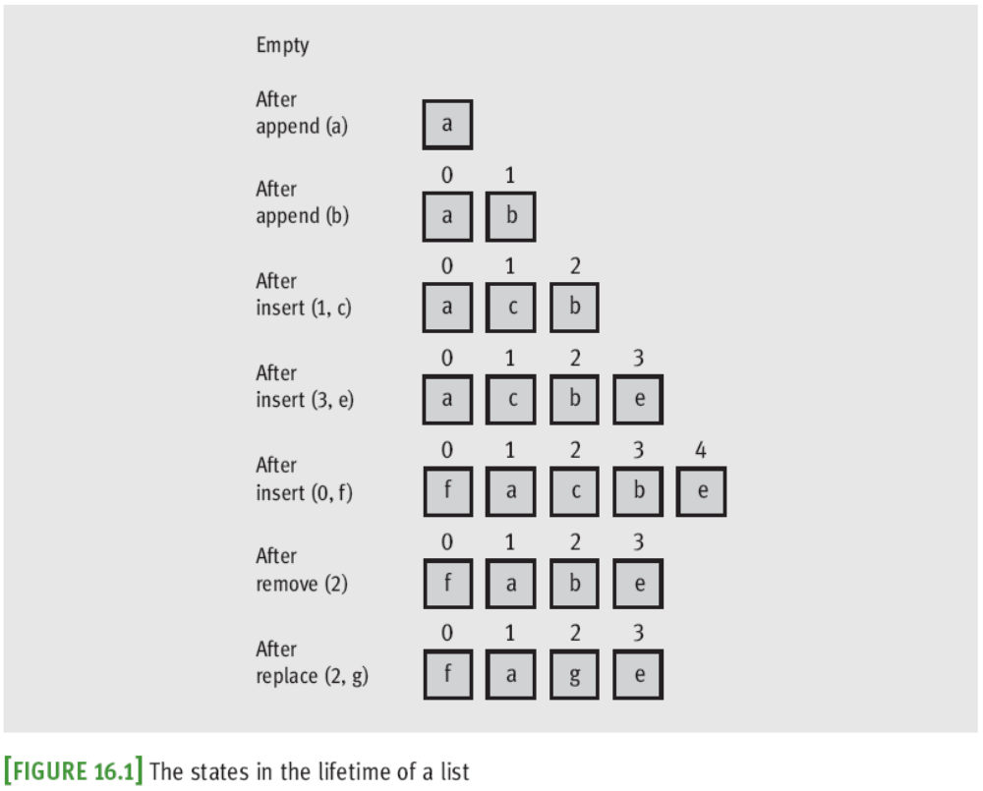
Overview of Lists (continued)
Fundamentals of Python: From First Programs Through Data Structures

Slide 7
Using Lists
Universal agreement on the names of the fundamental operations for stacks and queues but for lists, there are no such standards
  The operation of putting a new item in a list is sometimes called “add” and sometimes “insert”
Broad categories of operations on lists:
  Index-based operations
  Content-based operations
  Position-based operations
Fundamentals of Python: From First Programs Through Data Structures

Slide 8
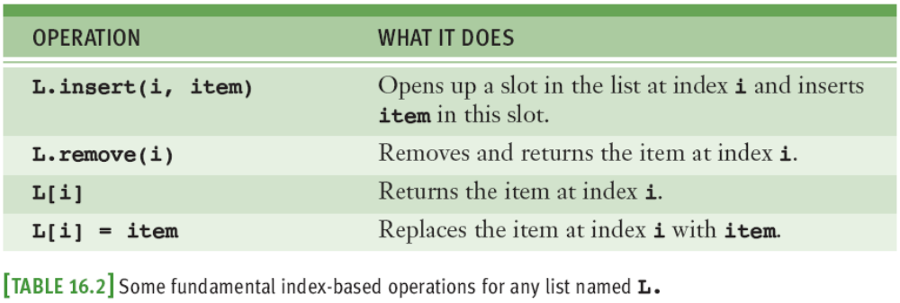
Index-Based Operations
Index-based operations manipulate items at designated indices within a list
  In array-based lists, these provide random access
From this perspective, lists are called vectors or sequences
Fundamentals of Python: From First Programs Through Data Structures

Slide 9
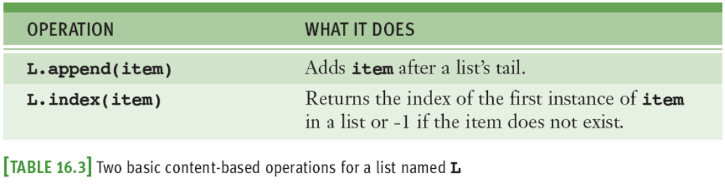
Content-Based Operations
Content-based operations are based not on an index, but on the content of a list
  Usually expect an item as an argument and do something with it and the list
Fundamentals of Python: From First Programs Through Data Structures

Slide 10
Position-Based Operations
Position-based operations: Performed relative to currently established position or cursor within a list
  Allow user to navigate the list by moving this cursor
In some programming languages, a separate object called an iterator provides these operations
Places in which a positional list’s cursor can be:
  Just before the first item
  Between two adjacent items
  Just after the last item
Fundamentals of Python: From First Programs Through Data Structures

Slide 11
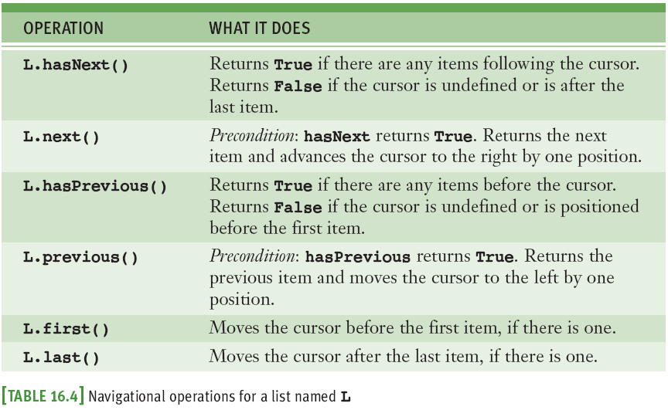
Position-Based Operations (continued)
Fundamentals of Python: From First Programs Through Data Structures

Slide 12
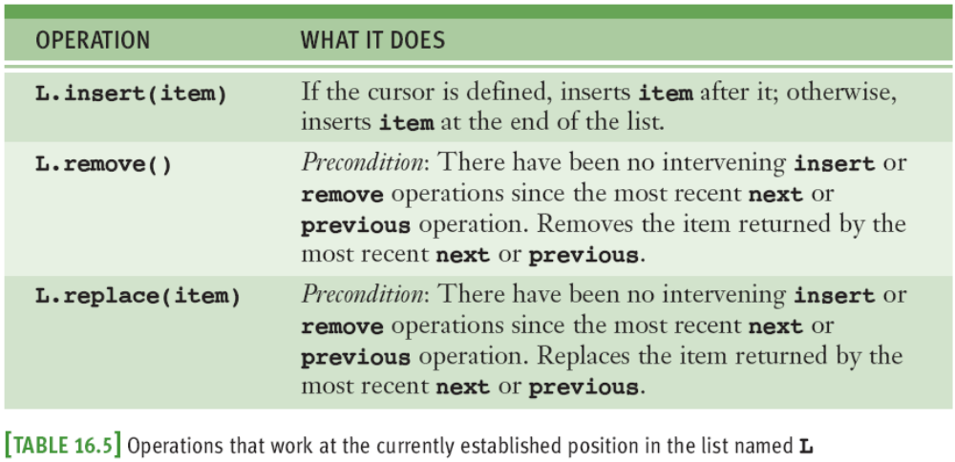
Position-Based Operations (continued)
When a positional list is first instantiated or when it becomes empty, its cursor is undefined
Fundamentals of Python: From First Programs Through Data Structures

Slide 13
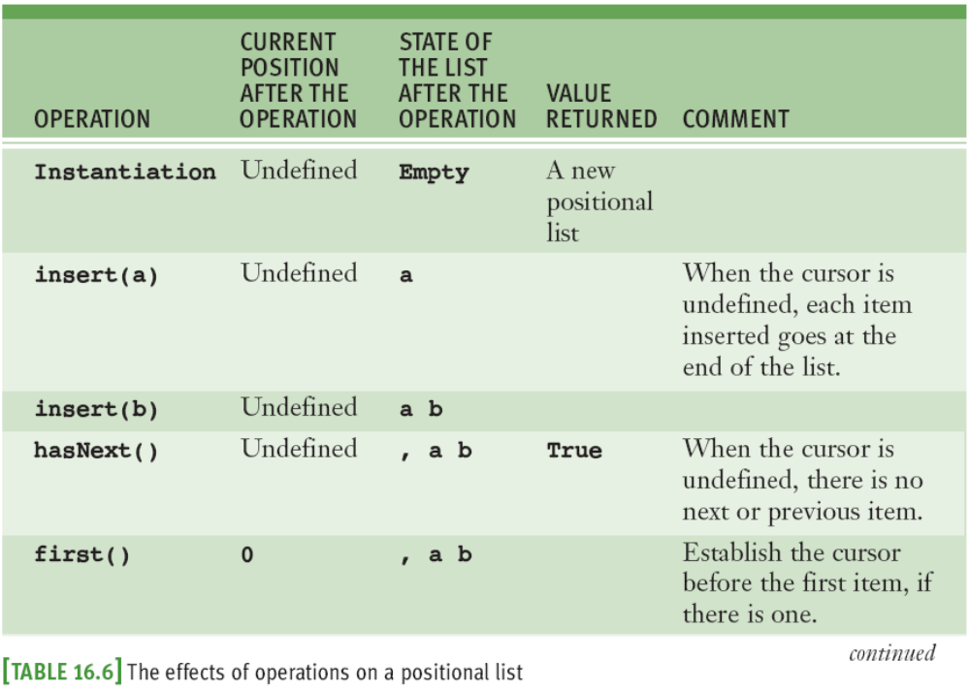
Position-Based Operations (continued)
Fundamentals of Python: From First Programs Through Data Structures

Slide 14
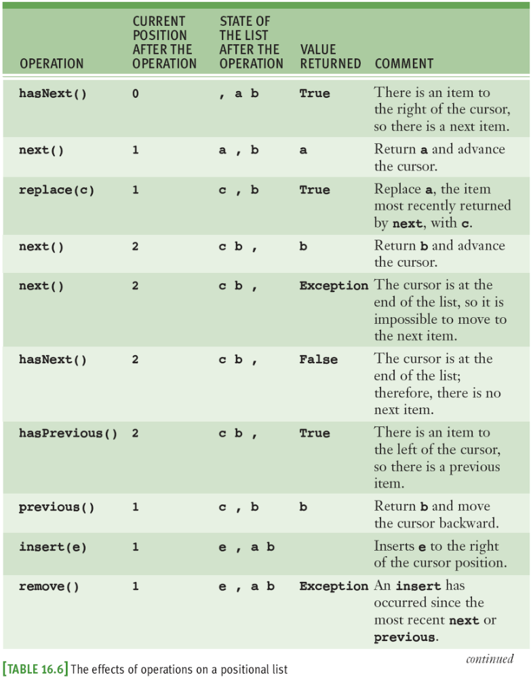
Position-Based Operations (continued)
Fundamentals of Python: From First Programs Through Data Structures

Slide 15
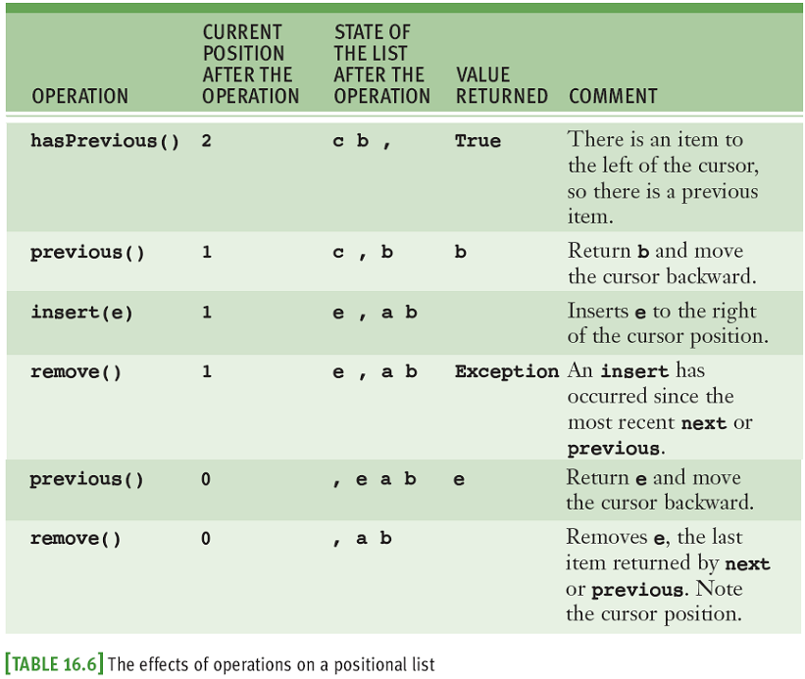
Position-Based Operations (continued)
Fundamentals of Python: From First Programs Through Data Structures

Slide 16
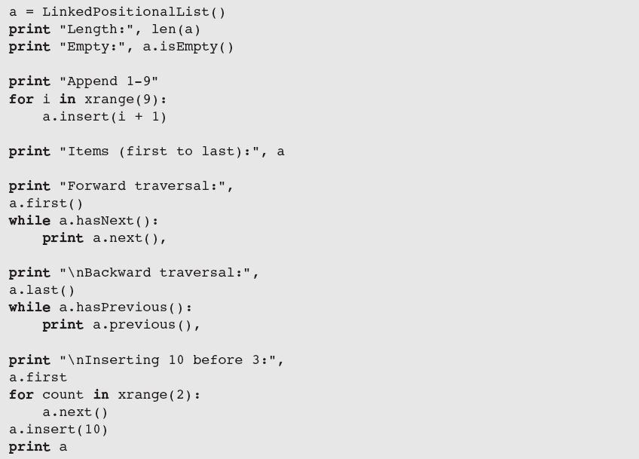
Position-Based Operations (continued)
Fundamentals of Python: From First Programs Through Data Structures

Slide 17
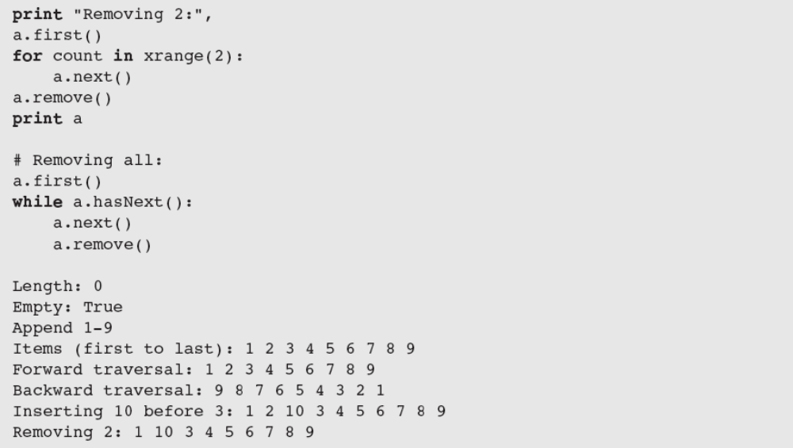
Position-Based Operations (continued)
Fundamentals of Python: From First Programs Through Data Structures

Slide 18
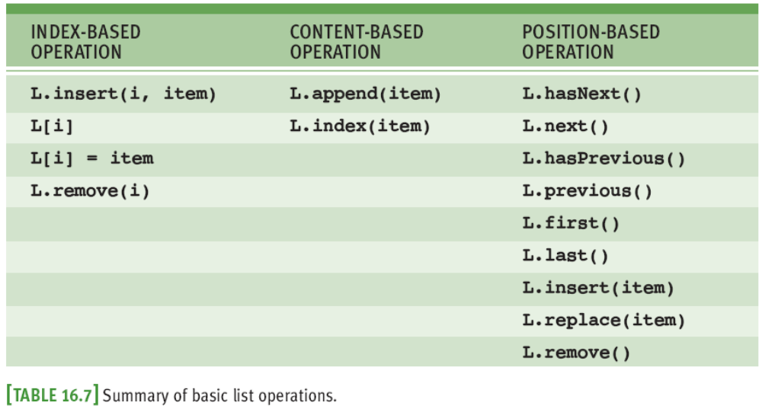
Interfaces for Lists
Fundamentals of Python: From First Programs Through Data Structures

Slide 19
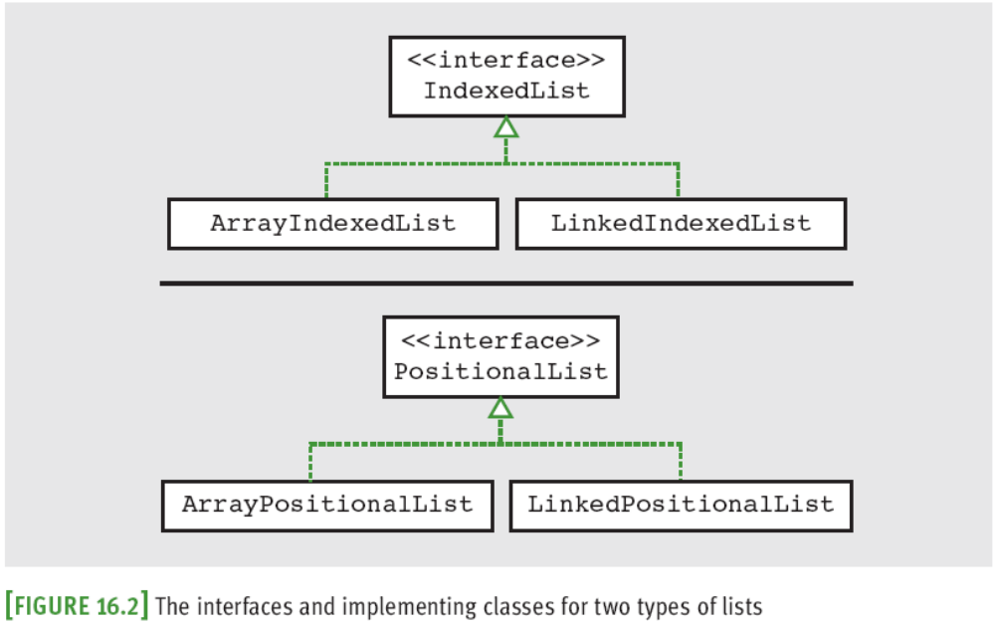
Interfaces for Lists (continued)
Fundamentals of Python: From First Programs Through Data Structures

Slide 20
Applications of Lists
Lists are probably the most widely used collections in computer science
In this section, we examine two important applications:
  Heap-storage management
  Disk file management
Fundamentals of Python: From First Programs Through Data Structures

Slide 21
Heap-Storage Management
Object heap: Area of memory from which PVM allocates segments for new data objects
When an object no longer can be referenced from a program, PVM can return that object’s memory segment to the heap for use by other objects
Heap-management schemes can have a significant impact on an application’s overall performance
  Especially if the application creates and abandons many objects during the course of its execution
Fundamentals of Python: From First Programs Through Data Structures

Slide 22
Heap-Storage Management (continued)
Contiguous blocks of free space on the heap can be linked together in a free list
  Scheme has two defects:
    Over time, large blocks on the free list become fragmented into many smaller blocks
    Searching free list for blocks of sufficient size can take O(n) running time (n is the number of blocks in list)
  Solutions:
    Have garbage collector periodically reorganize free list by recombining adjacent blocks
    To reduce search time, multiple free lists can be used
Fundamentals of Python: From First Programs Through Data Structures

Slide 23
Organization of Files on a Disk
Major components of a computer’s file system:
  A directory of files, the files, and free space
The disk’s surface is divided into concentric tracks, and each track is further subdivided into sectors
  (t, s) specifies a sector’s location on the disk
A file system’s directory is organized as a hierarchical collection
  Assume it occupies the first few tracks on the disk and contains an entry for each file
Fundamentals of Python: From First Programs Through Data Structures

Slide 24
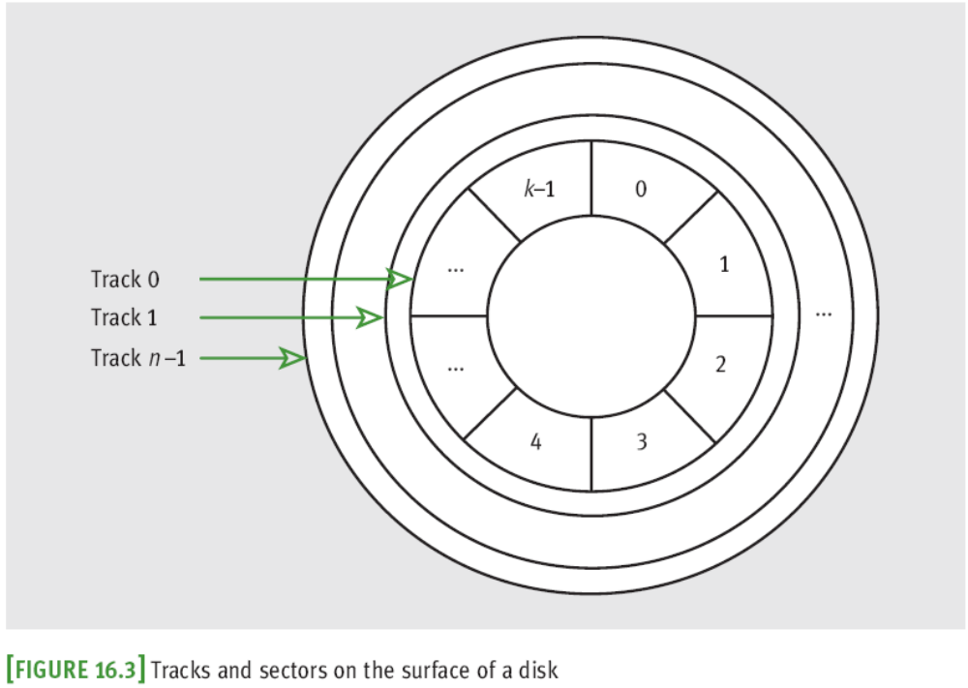
Organization of Files on a Disk (continued)
Fundamentals of Python: From First Programs Through Data Structures

Slide 25
Organization of Files on a Disk (continued)
A file might be completely contained within a single sector or might span several sectors
  Usually, the last sector is only partially full
The sectors that make up a file do not need to be physically adjacent
  Each sector except last one ends with a pointer to the sector containing the next portion of the file
Unused sectors are linked together in a free list
A disk system’s performance is optimized when multisector files are not scattered across the disk
Fundamentals of Python: From First Programs Through Data Structures

Slide 26
Implementation of Other ADTs
Lists are frequently used to implement other collections, such as stacks and queues
Two ways to do this:
  Extend the list class
    For example, to implement a sorted list
  Use an instance of the list class within the new class and let the list contain the data items
    For example, to implement stacks and queues
ADTs that use lists inherit their performance characteristics
Fundamentals of Python: From First Programs Through Data Structures

Slide 27
Indexed List Implementations
We develop array-based and linked implementations of the IndexedList interface and a linked implementation of the PositionalList interface
Fundamentals of Python: From First Programs Through Data Structures

Slide 28
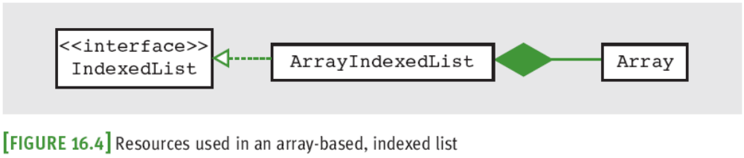
An Array-Based Implementation of an Indexed List
An ArrayIndexedList maintains its data items in an instance of the Array class
  Uses instance variable to track the number of items
  Initial default capacity is automatically increased when append or insert needs room for a new item
Fundamentals of Python: From First Programs Through Data Structures

Slide 29
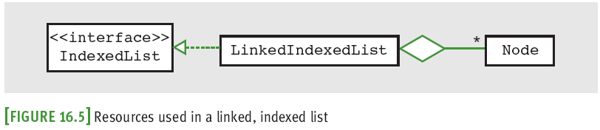
A Linked Implementation of an Indexed List
The structure used for a linked stack, which has a pointer to its head but not to its tail, would be an unwise choice for a linked list
The singly linked structure used for the linked queue (with head and tail pointers) works better
  append puts new item at tail of linked structure
Fundamentals of Python: From First Programs Through Data Structures

Slide 30
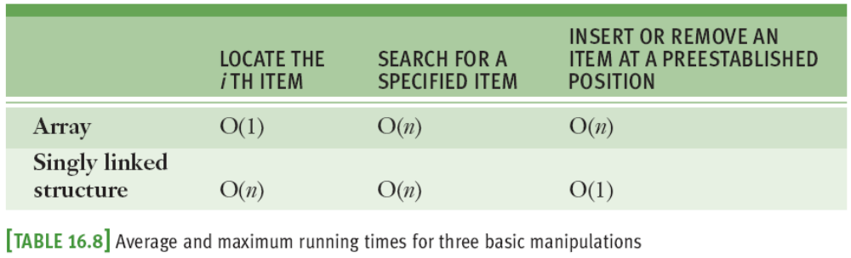
Time and Space Analysis for the Two Implementations
The running times of the IndexedList methods can be determined in the following ways:
  Examine the code and do the usual sort of analysis
  Reason from more general principles
We take the second approach
Fundamentals of Python: From First Programs Through Data Structures

Slide 31
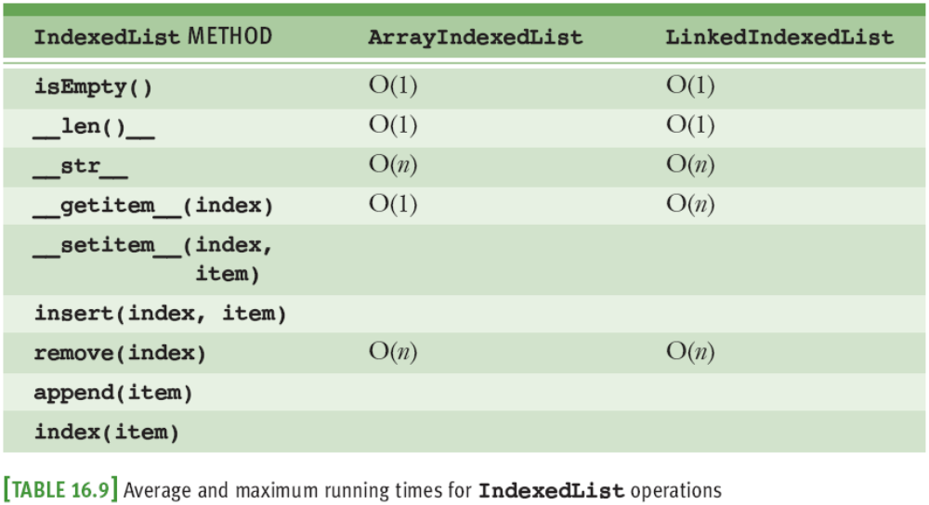
Time and Space Analysis for the Two Implementations (continued)
Fundamentals of Python: From First Programs Through Data Structures

Slide 32
Time and Space Analysis for the Two Implementations (continued)
Space requirement for array implementation is capacity + 2, which comes from:
  An array that can hold capacity references
  A reference to the array
  A variable for the number of items
Space requirement for the linked implementation is 2n + 3, which comes from:
  n data nodes; each node containing two references
  Variables that point to the first and last nodes
  A variable for the number of items
Fundamentals of Python: From First Programs Through Data Structures

Slide 33
Implementing Positional Lists
Positional lists use either arrays or linked structures
In this section, we develop a linked implementation
  Array-based version is left as an exercise for you
Fundamentals of Python: From First Programs Through Data Structures

Slide 34
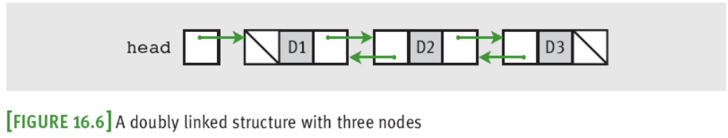
The Data Structures for a Linked Positional List
We don’t use a singly linked structure to implement a positional list because it provides no convenient mechanism for moving to a node’s predecessor
Code to manipulate a list can be simplified if a sentinel node is added at the head of the list
  Points forward to what was the first node and backward to what was the last node
Fundamentals of Python: From First Programs Through Data Structures

Slide 35
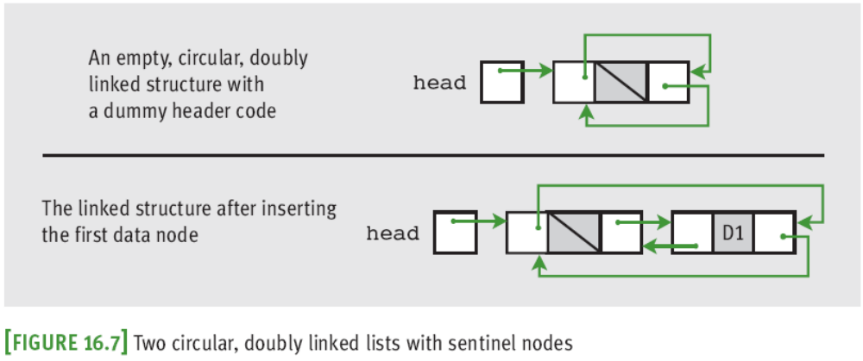
The Data Structures for a Linked Positional List (continued)
The head pointer now points to the sentinel node
Resulting structure resembles circular linked structure studied earlier
Fundamentals of Python: From First Programs Through Data Structures

Slide 36
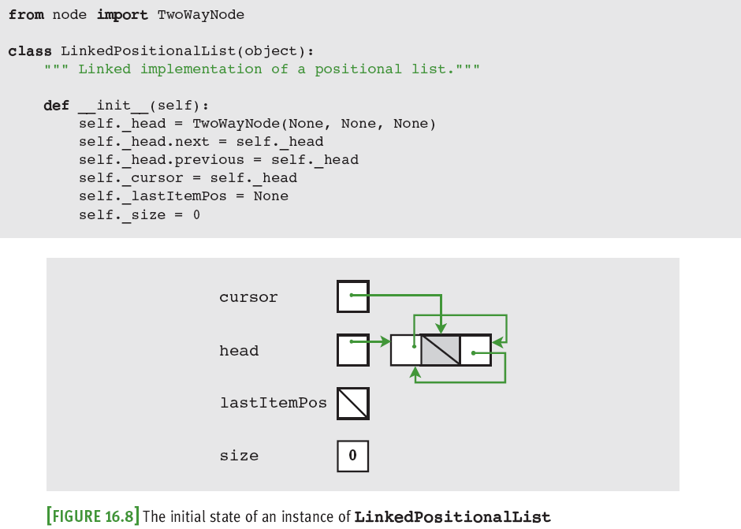
The Data Structures for a Linked Positional List (continued)
Fundamentals of Python: From First Programs Through Data Structures

Slide 37
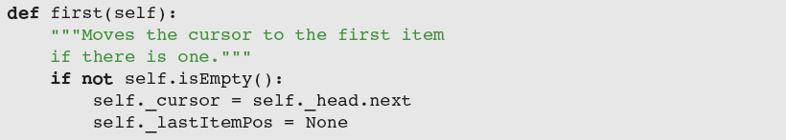
Methods Used to Navigate from Beginning to End
Purpose of hasNext is to determine whether next can be called to move the cursor to the next item
first moves cursor to first item, if there is one
  Also resets lastItemPos pointer to None, to prevent replace and remove from being run at this point
Fundamentals of Python: From First Programs Through Data Structures

Slide 38
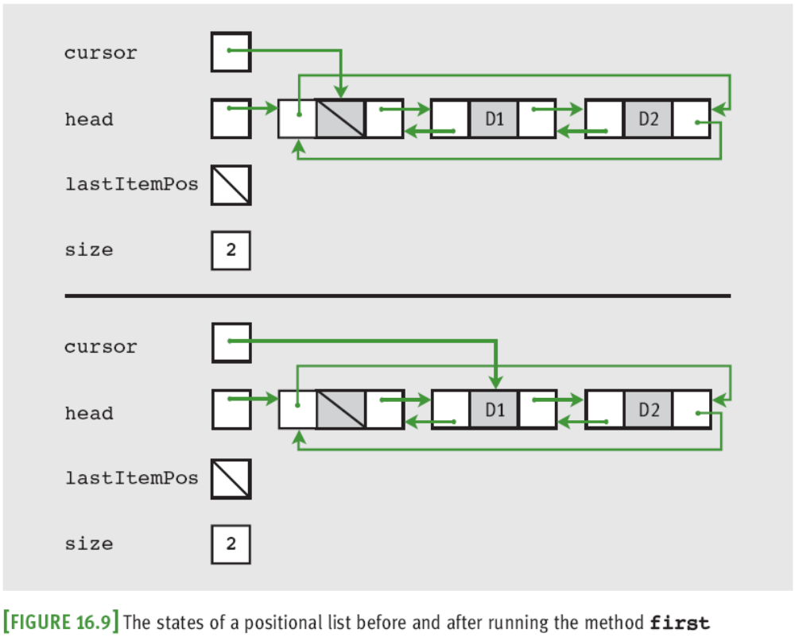
Methods Used to Navigate from Beginning to End (continued)
Fundamentals of Python: From First Programs Through Data Structures

Slide 39
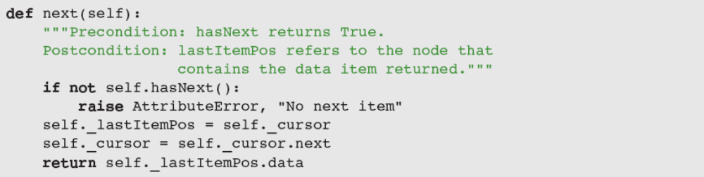
Methods Used to Navigate from Beginning to End (continued)
next cannot be run if hasNext is False
  Raises an exception if this is the case
  Otherwise, sets lastItemPos to cursor’s node, moves cursor to next node, and returns item at lastItemPos
Fundamentals of Python: From First Programs Through Data Structures

Slide 40
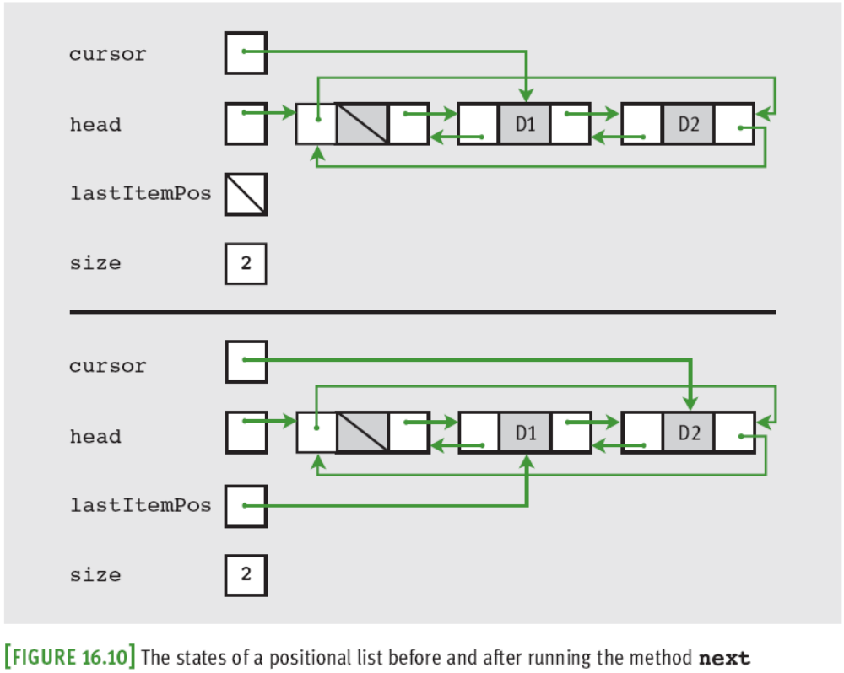
Methods Used to Navigate from Beginning to End (continued)
Fundamentals of Python: From First Programs Through Data Structures

Slide 41
Methods Used to Navigate from End to Beginning
Where should the cursor be placed to commence a navigation from the end of the list to its beginning?
  When previous is run, cursor should be left in a position where the other methods can appropriately modify the linked structure
  last places the cursor at the header node instead
    Header node is node after the last data node
  hasPrevious returns True when cursor’s previous node is not the header node
Fundamentals of Python: From First Programs Through Data Structures

Slide 42
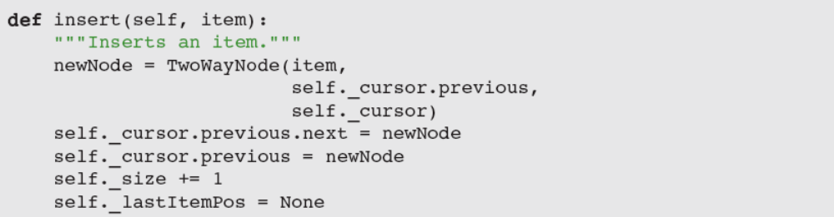
Insertions into a Positional List
Scenarios in which insertion can occur:
  Method hasNext returns False
  ➔ new item is inserted after the last one
  Method hasNext returns True
  ➔ new item is inserted before the cursor’s node
Fundamentals of Python: From First Programs Through Data Structures

Slide 43
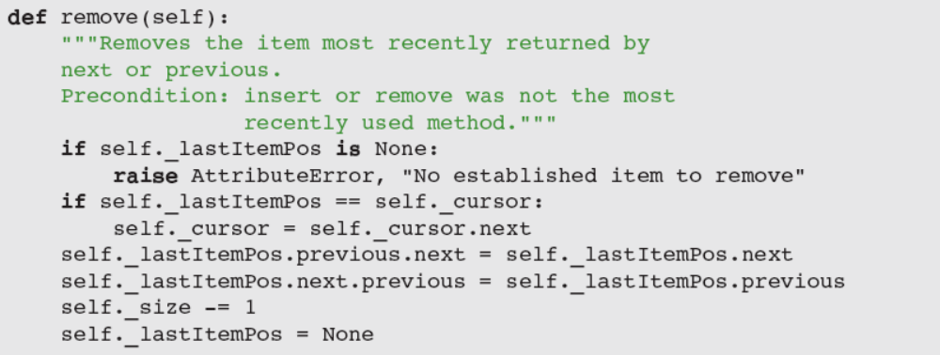
Removals from a Positional List
remove removes item most recently returned by a call to next or previous
  Should not be called right after insert/remove
  Uses lastItemPos to detect error or locate node
Fundamentals of Python: From First Programs Through Data Structures

Slide 44
Time and Space Analysis of Positional List Implementations
There is some overlap in the analysis of positional lists and index-based lists, especially with regard to memory usage
  Use of a doubly linked structure adds n memory units to the tally for the linked implementation
The running times of all of the methods, except for __str__, are O(1)
Fundamentals of Python: From First Programs Through Data Structures

Slide 45
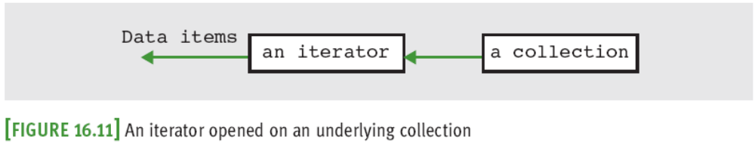
Iterators
Python’s for loop allows programmer to traverse items in strings, lists, tuples, and dictionaries:
Python compiler translates for loop to code that uses a special type of object called an iterator
Fundamentals of Python: From First Programs Through Data Structures

Slide 46
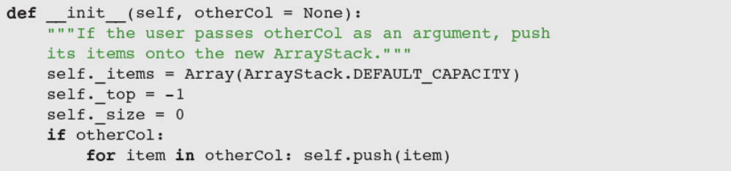
Iterators (continued)
If every collection included an iterator, you could define a constructor that creates an instance of one type of collection from items in any other collection:
Users of ArrayStack can run code such as:
  s = ArrayStack(aQueue)
  s = ArrayStack(aString)
Fundamentals of Python: From First Programs Through Data Structures

Slide 47
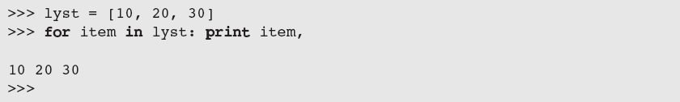
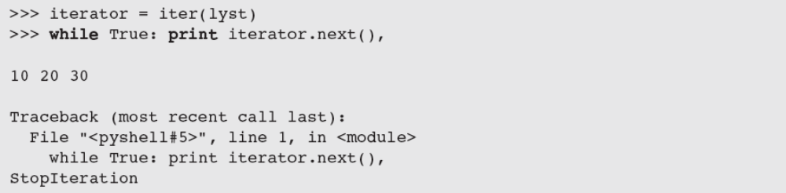
Using an Iterator in Python
Python uses an iterator to access items in lyst
Fundamentals of Python: From First Programs Through Data Structures

Slide 48
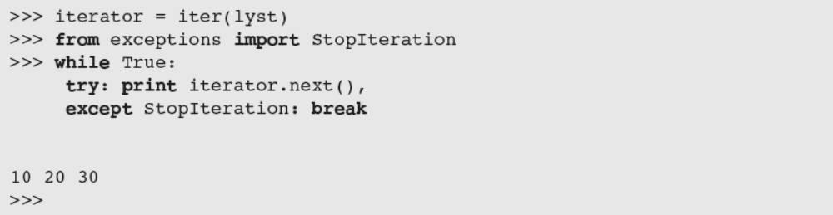
Using an Iterator in Python (continued)
Although there is no clean way to write a normal loop using an iterator, you can use a try-except statement to handle the exception
The for loop is just “syntactic sugar,” or shorthand, for an iterator-based loop
Fundamentals of Python: From First Programs Through Data Structures

Slide 49
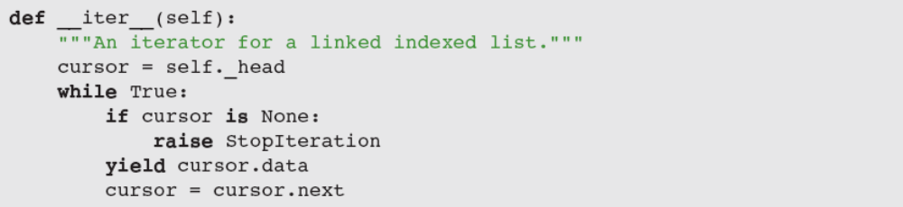
Implementing an Iterator
Define method to be called when iter function is run: __iter__
  Expects only self as an argument
  Automatically builds and returns a generator object
Fundamentals of Python: From First Programs Through Data Structures

Slide 50
Case Study: Developing a Sorted List
Request:
  Develop a sorted list collection
Analysis:
  Client should be able to use the basic collection operations (e.g., str, len, isEmpty), as well as the index-based operations [] for access and remove and the content-based operation index
  An iterator can support position-based traversals
Fundamentals of Python: From First Programs Through Data Structures

Slide 51
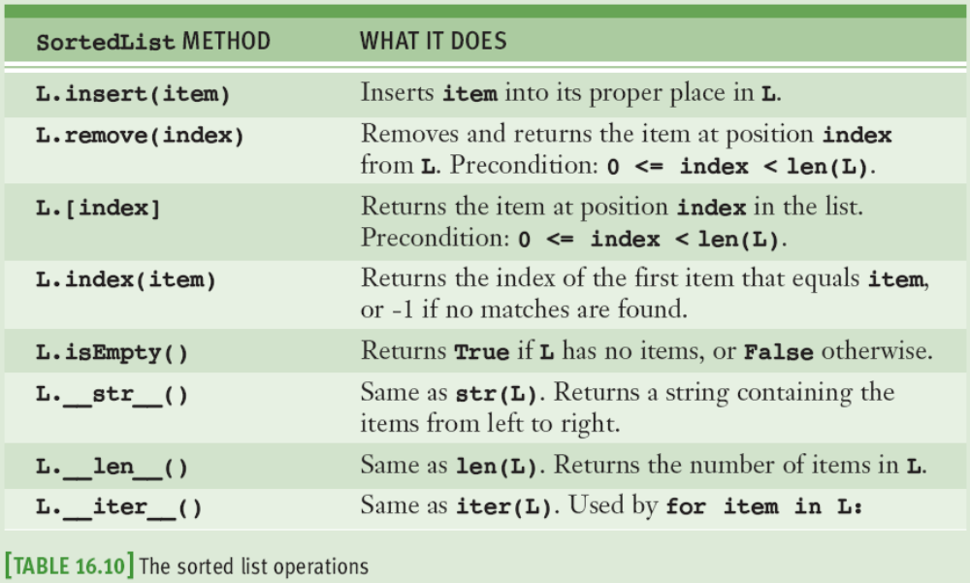
Case Study: Developing a Sorted List (continued)
Fundamentals of Python: From First Programs Through Data Structures

Slide 52
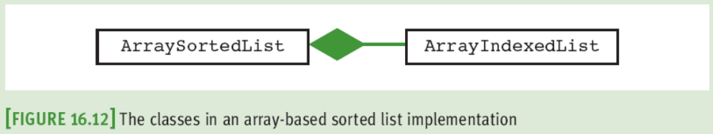
Case Study: Developing a Sorted List (continued)
Design:
  Because we would like to support binary search, we develop just an array-based implementation, named ArraySortedList
Fundamentals of Python: From First Programs Through Data Structures

Slide 53
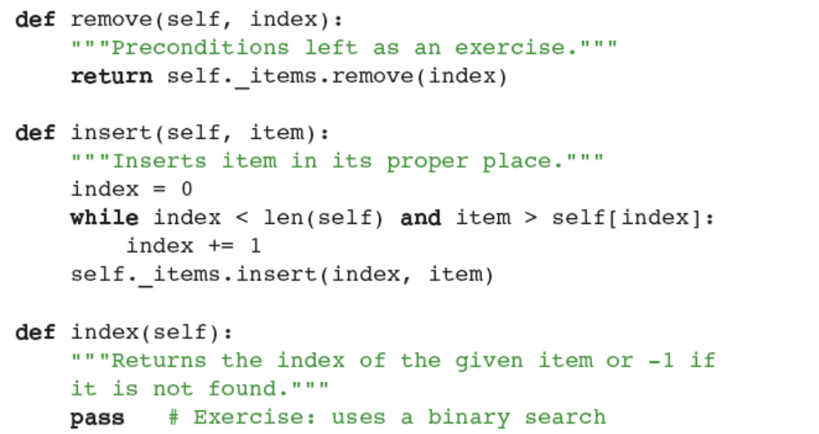
Case Study: Developing a Sorted List (continued)
Checking some preconditions and completing the index method are left as exercises for you
Fundamentals of Python: From First Programs Through Data Structures

Slide 54
Summary
A list is a linear collection that allows users to insert, remove, access, and replace elements at any position
Operations on lists are index-based, content-based, or position-based
  An index-based list allows access to an element at a specified integer index
  A position-based list lets the user scroll through it by moving a cursor
Fundamentals of Python: From First Programs Through Data Structures

Slide 55
Summary (continued)
List implementations are based on arrays or on linked structures
  A doubly linked structure is more convenient and faster for a positional list than a singly linked structure
An iterator is an object that allows a user to traverse a collection and visit its elements
  In Python, a collection can be traversed with a for loop if it supports an iterator
A sorted list is a list whose elements are always in ascending or descending order
Fundamentals of Python: From First Programs Through Data Structures

